Slide 1

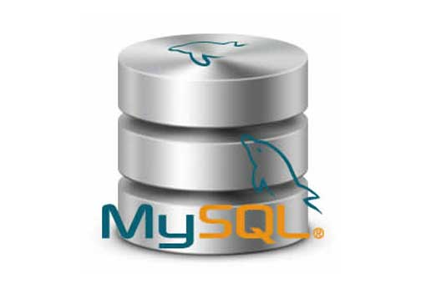
What is WSDL and UDDI?
Web Services
[Services available over the web]
To enable communication between two applications
Request
Application developed using Java
Application developed using .NET
Response

Slide 2
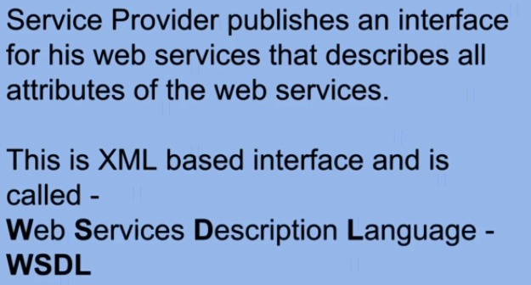


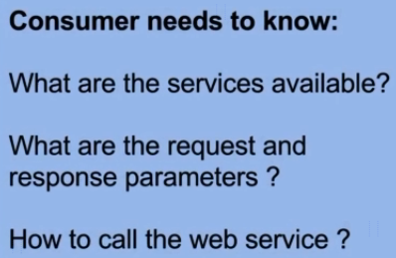
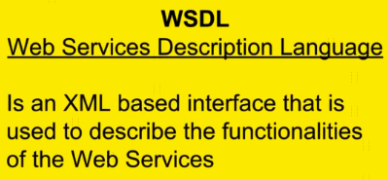
What is WSDL and UDDI?

Slide 3
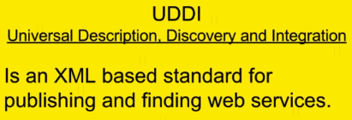
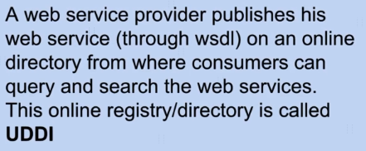

What is WSDL and UDDI?
WSDL
2
1
Get the WSDL and
use the Webservice
Creates WSDL
Request
Client
(Service Consumer)
Server
(Service Provider)
Response

Slide 4
What is a Web Service?
https://www.udemy.com/course/web-services-api-step-by-step-beginner-tutorial/learn/lecture/10047720#overview

